Slide 1
Get ready. Get Agile.
USING AGILE METHODS IN A DIGITAL TECHNOLOGIES CLASSROOM
PART 4: AGILE PROCESSES

Slide 2
Agile Processes
Several Agile frameworks exist:
Scrum (www.scrumguides.org/scrum-guide.html)
Kanban (www.smartsheet.com/agile-vs-scrum-vs-waterfall-vs-kanban)
Scrumban (blends Scrum and Kanban)
LSD (Lean Software Development)
XP (eXtreme Programming)
There are others. While individual frameworks may use different practices, the principles are largely the same.

Slide 3
Agile Processes
Agile values and principles guide project development:
Scrum
based on teams, committed to shipping working software, at set intervals named Sprints.
gather customer feedback and integrate in learning loops.
utilise specific roles, create specific artefacts, and hold regular “ceremonies” that keep projects moving.

Slide 4
Agile Processes
Kanban
uses visualization, and a limit on work in progress (WIP).
prioritises efficiency, or flow.
focuses on reducing the time it takes to take a project through to completion.
the central feature is the Kanban board and a focus on improving work flow.

Slide 5
Agile Processes
Kanban
Our focus will be on Kanban.
Kanban originated in manufacturing.
In Japanese it means “visual signal” or “signal board.”
Although designed for small teams, for our purposes it can be used by individual students, to track, prioritise and develop classroom projects.

Slide 6
Agile Processes
Kanban board
A Kanban board is a visual method of organising tasks.
Think of it as a large, prioritized to-do list.
The visualisation focusses on 3 fundamentals:
a card represents a one task,
the Kanban board hosts all cards,
boards are divided into columns, each representing the state that the task occupies.

Slide 7
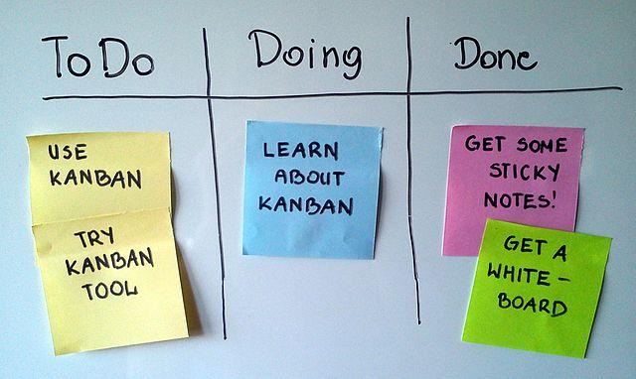
Agile Processes
Furthest left is the initial state, and furthest right is the final state: new cards are created on the left, progressing across the board to the right.
In its simplest form, a board has three categories allocated:
To do (backlog)
Doing (in development, or testing)
Done (list of completed components)
Figure 1: A Scrum board suggesting to use Kanban, by Jeff.lasovski, via Wikicommons

Slide 8
Agile Processes
To-Do visually manages tasks yet to be completed, and whether more workers or resourcing is required to complete the current iteration.
Doing is the focus. Must not contain too many items, or the system becomes overloaded. Ideally, it should only contain 1 main task, and 1 or 2 smaller tasks complementing the main task. Too many tasks in “Doing” is unrealistic and risks the team losing focus.
Done shouldn’t require explanation. Items moved to “Done” help to encourage and motivate.

Slide 9
Agile Processes
WIP (Work in Progress)
Focus on work actively in progress.
Complete a work item (card) and select the next item from the top of the backlog.
The product owner can re-prioritize work in the backlog without disrupting development, as any changes outside current work priorities have no impact on current workflow.

Slide 10
Agile Processes
WIP (Work in Progress)
Keeping the most important work on top of the backlog assures a delivery that maximises value
There is no need for the fixed-length iterations such as in Scrum.
Limiting WIP is key in Kanban. No developer can do more work than they can handle. The trick is to choose work wisely.

